Slide 1
BUOYANCY,DIVING AND PHYSIOLOGICAL RESPONSES TO PROLONGED DIVES
GROUP 28
1

Slide 2
CONTENTS
Introduction
Definition of Buoyancy and Diving
Organ Systems Involved In Physiological Responses
Physiological Responses To Prolonged Dives
Importance Of Physiological Responses To Prolonged Dives
Importance Of Buoyancy In Diving
Conclusion
References
2

Slide 3
INTRODUCTIONTR
Series of physiological changes that takes place in mammals in response to water submersion is known as a dive reflex.
This reflex aid in the conservation of oxygen in mammals by initiating several specific physiologic changes during aquatic immersion.(Smith et al., 2012)
3

Slide 4
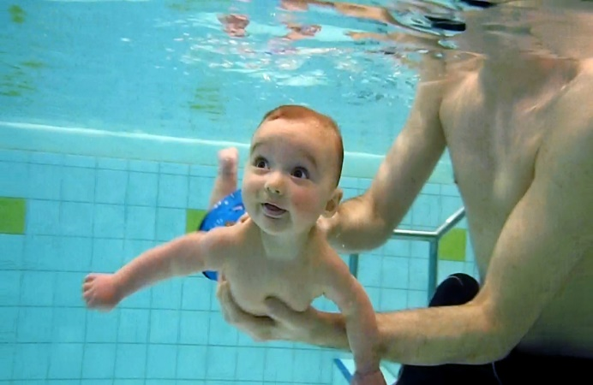
INTRODUCTION CONT’D
The dive reflex was first described by Edmund Goodwyn in 1786.
Three main physiological changes occurs in a diving reflex; bradycardia, apnea and increased peripheral vascular resistance.
4 Fig. 1

Slide 5
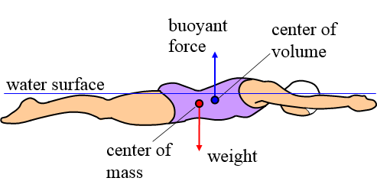
BUOYANCY
Buoyancy is the tendency of a body to float or rise in a fluid when the body is submerged in the fluid.
When a body is less dense than the fluid, it experiences a buoyant force greater than its weight, thereby making the body float.
5
Fig. 2

Slide 6


DIVING
Diving is the act of entering and moving through water head foremost, typically to interact with the environment beneath water surface.
Fig. 3 Fig. 4 6
6

Slide 7
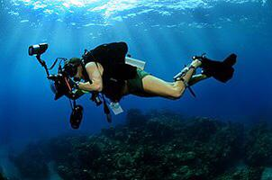
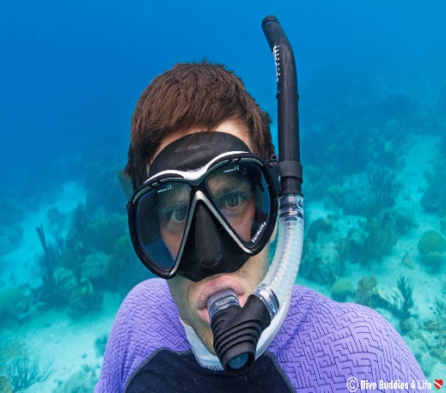

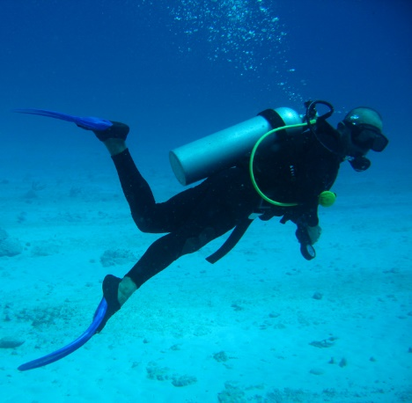
TYPES OF DIVING
Scuba diving Snorkelling Free diving Deep-sea
diving
7
Fig. 5

Slide 8
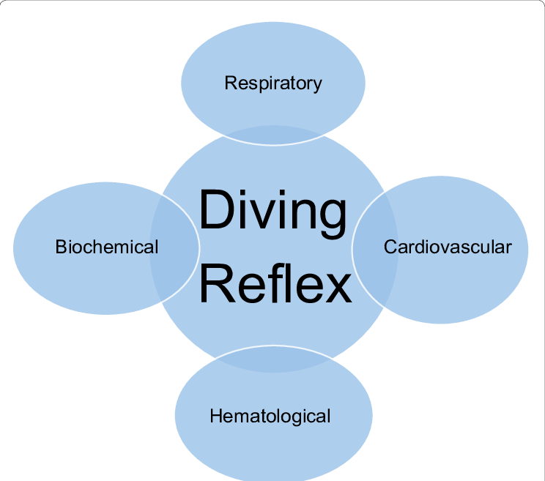
ORGAN SYSTEMS INVOLVED IN PHYSIOLOGICAL RESPONSES
Nervous system
Pulmonary system
Cardiovascular system
8*
Fig. 6

Slide 9
PHYSIOLOGICAL RESPONSES TO PROLONGED DIVES
During prolonged dives, the bodies of both animals and humans must adapt to the challenges of reduced oxygen and increased pressure under water.
9

Slide 10
PHYSIOLOGICAL RESPONSES TO PROLONGED DIVES CONT’D
In marine mammals such as whales and seals, physiological responses include;
Bradycardia
Reduced peripheral blood flow
Decreased blood volume
Myoglobin storage
Enhanced lung collapse and enhanced oxygen storage in the tissues 10

Slide 11
PHYSIOLOGICAL RESPONSES TO PROLONGED DIVES CONT’D
In humans, the physiological responses the body goes through during prolonged diving are;
Lung compression
Peripheral vasoconstriction
Hypoxia
Bradycardia
Blood redistribution.
11
Marabotti et al., 2008

Slide 12
IMPORTANCE OF PHYSIOLOGICAL RESPONSES TO PROLONGED DIVES
Physiological responses are of utmost importance for both marine mammals and human divers by;
Ensuring the survival of organisms under water
Conserving oxygen
Enabling mammals to stay underneath water for extended times
Minimizing decompression risks
12

Slide 13
IMPORTANCE OF BUOYANCY IN DIVING
Buoyancy allows divers to control their descent and ascent in water column
It helps conserve energy in divers
It allow the diver to maintain an appropriate depth
13

Slide 14

CONCLUSION
Buoyancy, diving and the physiological responses to prolonged dives demonstrate the incredible diversity and ingenuity of life in aquatic environments and human exploration beneath the waves
14

Slide 15
REFERENCES
Smith G., Morgans A., Taylor and Cameron. Use of the human dive reflex for the management of the supraventricular tachycardia, a review of literature. Emerg Med J. 2012
Marabotti c., Belardinelli A., L’Abbate A., Scalzini A. Cardiac function durin breath-hold diving in humans. Undersea Hyperb Med. 2008. 35(2) 38-90
15

Slide 16


